Slide 1
Applications of Information & Communication Technology
Mr. Ali Haider
Institute Of Management Sciences

Slide 2
HTML Form
An HTML form is used to collect user input. The user input is most often sent to a server for processing.
The HTML <form> element is used to create an HTML form for user input.
The <form> element is a container for different types of input elements, such as: text fields, checkboxes, radio buttons, submit buttons, etc.

Slide 3
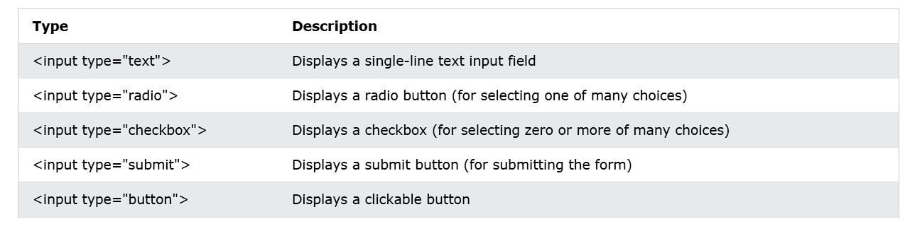
<input> Element
The HTML <input> element is the most used form element.
An <input> element can be displayed in many ways, depending on the type attribute.

Slide 4
<label> Element
The <label> tag defines a label for many form elements.
The <label> element is useful for screen-reader users, because the screen-reader will read out loud the label when the user focuses on the input element.
The <label> element also helps users who have difficulty clicking on very small regions (such as radio buttons or checkboxes) - because when the user clicks the text within the <label> element, it toggles the radio button/checkbox.
The for attribute of the <label> tag should be equal to the id attribute of the <input> element to bind them together.

Slide 5
For, type, id, name, value Attribute
FOR
Purpose: Links a <label> to an input element by matching the value of for with the id of the input field.
Usage: Improves accessibility, allowing users to click on the label to focus on the associated input field.
TYPE
Purpose: Specifies the type of input element.
Values: Includes text, password, email, number, checkbox, radio, submit, etc.

Slide 6
For, type, id, name, value Attribute
ID
Purpose: Provides a unique identifier for an element, used for linking labels, styling with CSS, or targeting elements in JavaScript.
NAME
Purpose: Assigns a name to the input element, which is used as a key when form data is submitted.
VALUE
Purpose: Defines the default value for an input element, or the value sent to the server when the form is submitted.

Slide 7
Label, TextField, RadioButton
<form>
<label for = "username"> Username :</label>
<input type= "text" id="username" name="username"> <br>
<label for="gender"> Gender: </label>
<input type="radio" id=“male" name=“gender" value="Male">
<label for="male"> Male </label>
<input type="radio" id=“female" name=“gender" value="Female">
<label for="female"> Female</label> <br>
</form>

Slide 8
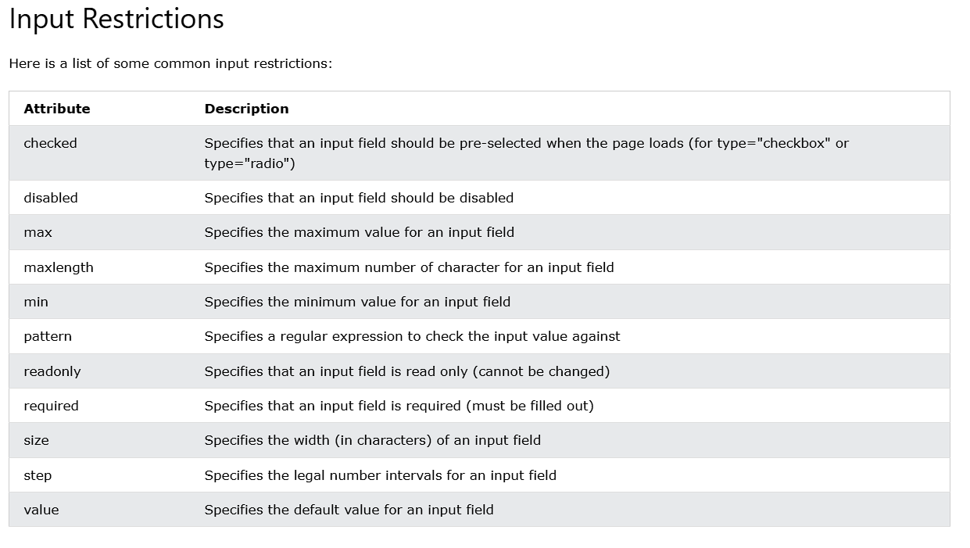
Input Element Restriction

Slide 9
Class Task
<input type=“email”>
<input type=“password”>
<input type=“number”>

Slide 10
Thank You.
The End

